Slide 1

store renting / selling movie DVDs.
analysis

Slide 2
films play an important role in shaping the society as well as providing a substantial percentage to the GDP of a country. Visual media entertainment is a multi-billion-dollar business, concentrated in film and television production. films are one of the most famous sources of entertainment. Movies also help us to live our imagination. It is also helpful in popularizing art and culture. They are also a source of educating people about different social issues.
$67406.56 Revenue is generated by renting films in year 2006.

Slide 3
Both stores are renting same numbers of films and earning same revenue.

Slide 4
Scarlett Damon films are renting has highest revenue.

Slide 5
TELEGRAPH VOYAGE earned highest revenue

Slide 6
Sports category has highest revenue

Slide 7
Total 714 films earned less than $100, which 74% of total films

Slide 8
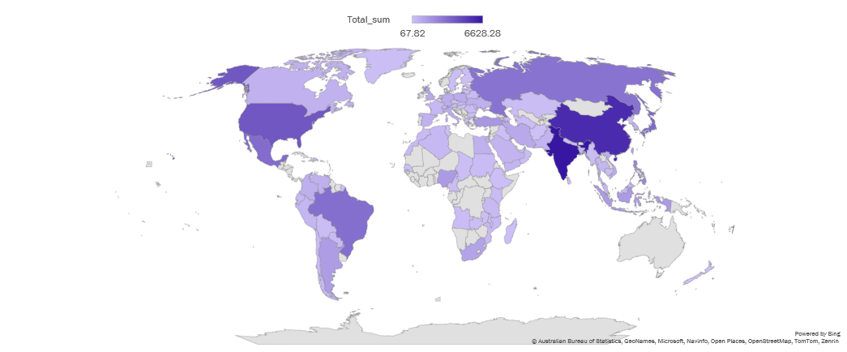
China and India generated highest revenue.

Slide 9
Duration does not impact the revenue.

Slide 10
Thank you

